Slide 1
Final Projects #3 Object Detection

Slide 2
Detect What ? CLOTHES !
You need to detect where the clothes are (bounding box) and predict every clothes LABEL
The classification result is correct if:
Center of bounding box is near ground truth, computed by IOU
The LABEL is correct
LABEL : type of clothes (judgment rule: 50% of length)
Short Top with Deep / Light color
Long Top with Deep / Light color
Short under with Deep / Light color
Long under with Deep / Light color

Slide 3
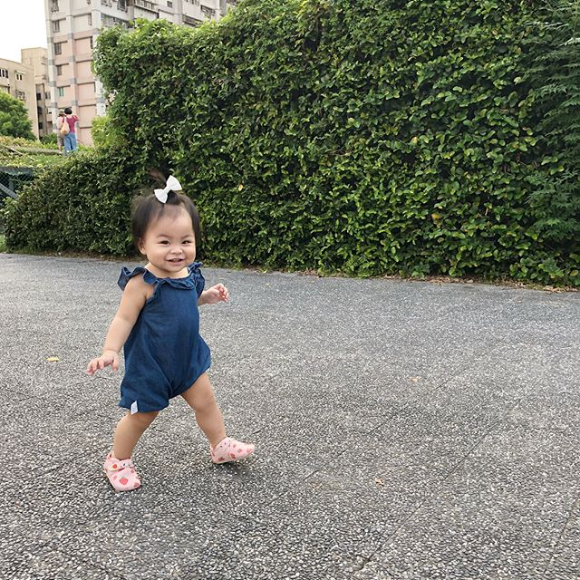
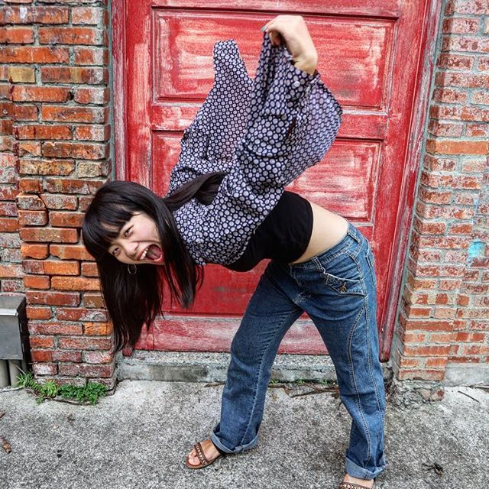
Examples, Just Two Examples !
Deep + LT
Abbreviation
L | Long
S | Short
U | Under
T | Top
Deep + ST
Deep + LU
Deep + SU

Slide 4
Where is Dataset From ?
We will prepare dataset for you, please don’t collect it or add more dataset by yourself
Dataset is collected from Instagram
We use some HASHTAG, e.g. #四四南村 #聚餐 #薰衣草花園 …
2000 images as your dataset, contain negative sample
Each image has corresponding label
All images are resized to 640x640
Testing dataset will not provided to you guys, only testing and validation

Slide 5

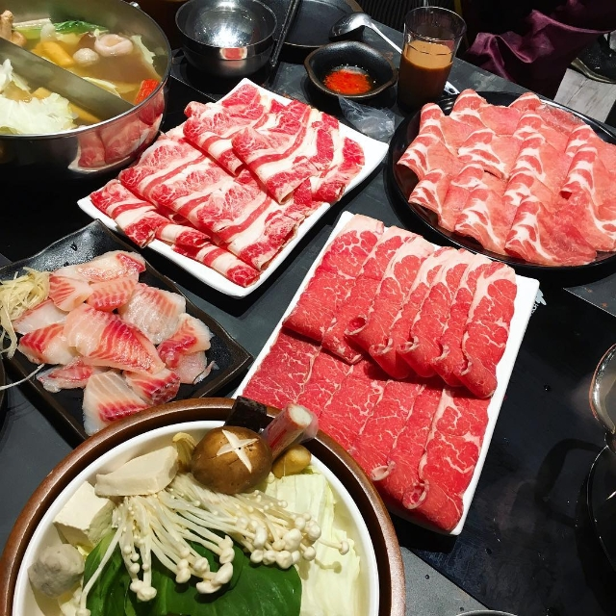

What Does Negative Sample Look Like?
Just a scenes
meat
Ambiguous for short or long

Slide 6
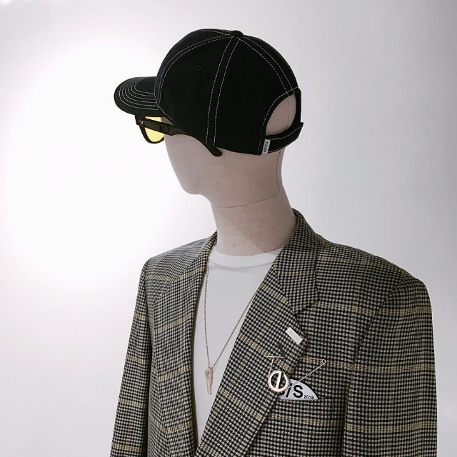
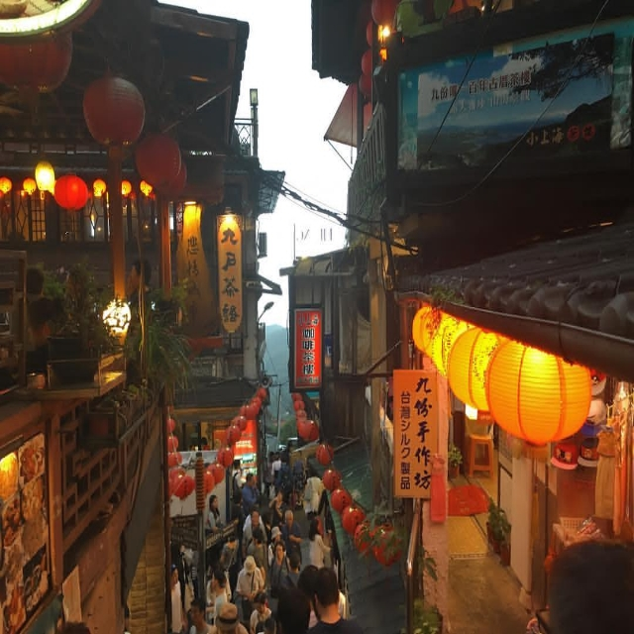
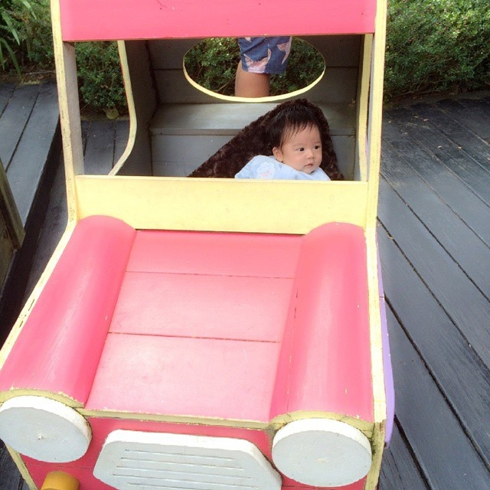
What Does Negative Sample Look Like?
Not a real man
People too small to detect
No available clothes

Slide 7

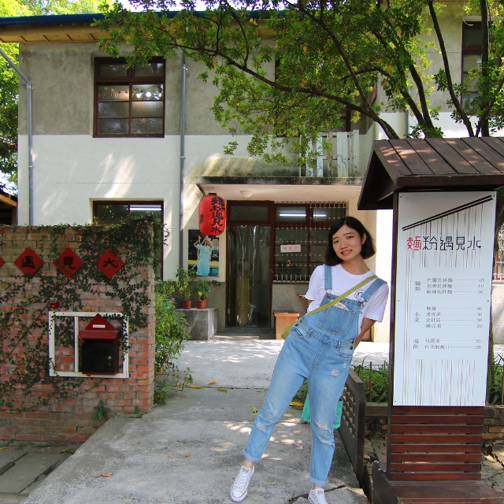
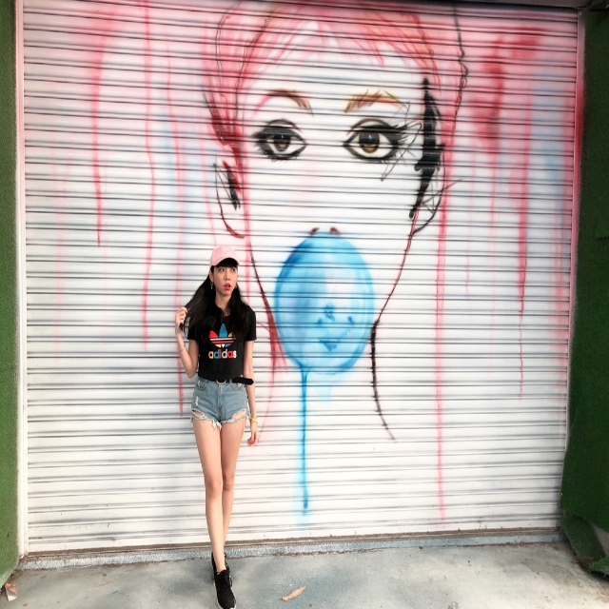
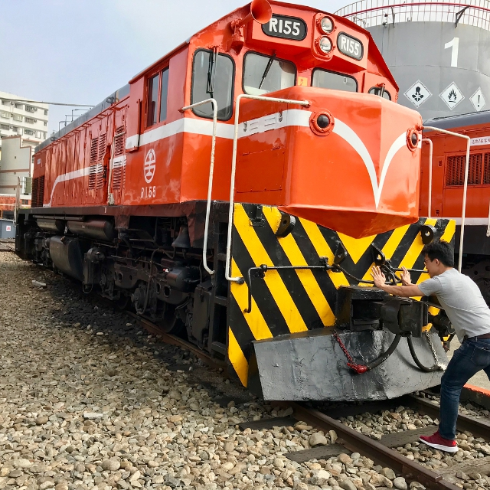
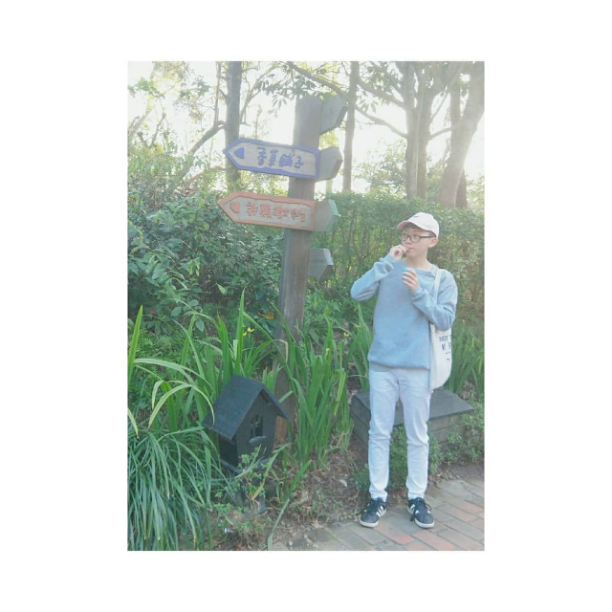
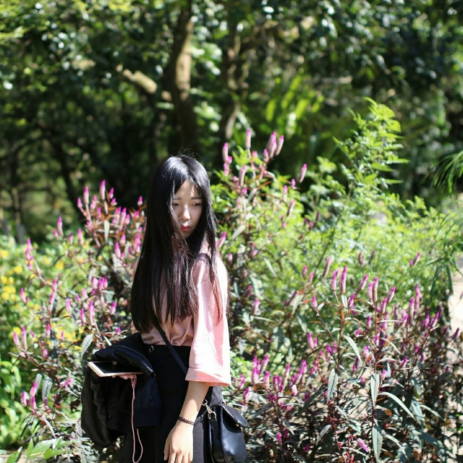
Disputation in Dataset: Is Deep or Light ?
Deep / Light color judgment is very subjective in people cognition, there are no standard rule for it
Please feel free to modify the label of image if necessary

Slide 8

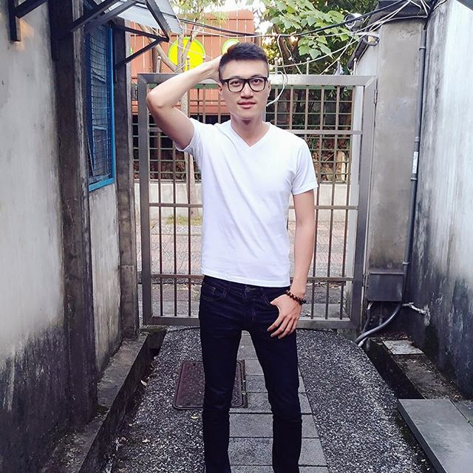

Does Testing Has Disputed Case?
NO, in the testing dataset will be clear as possible

Slide 9
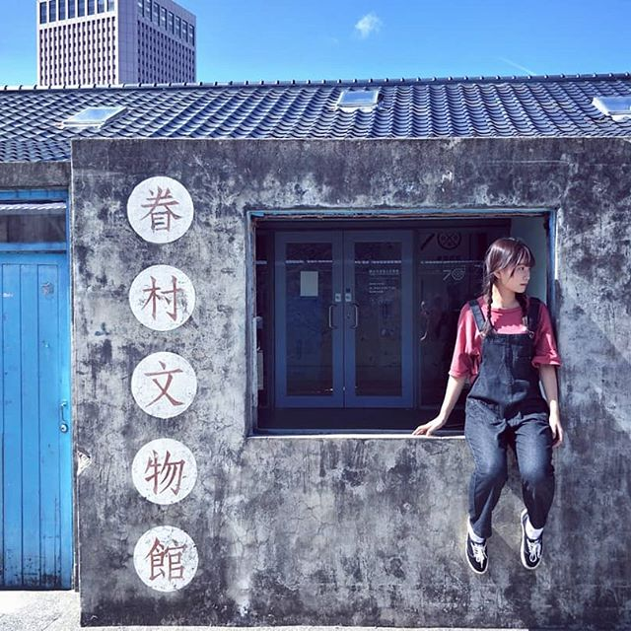
Input / Output Format
Output should be the same with input labels
Type
Center X
Center Y
Width
Height
0 0.800781 0.556250 0.179688 0.187500
6 0.806250 0.774219 0.137500 0.270313
The floating-point mean the ratio of Image size
Type Table
0: Deep + ST | 1: Light + ST
2: Deep + LT | 3: Light + LT
4: Deep + SU | 5: Light + SU
6: Deep + LU | 7: Light + LU

Slide 10
Intersection Over Union (IOU)
How do I know which predicted bounding box is corresponding to one in ground truth?
Ground Truth 2
Ground Truth 1
Prediction

Slide 11
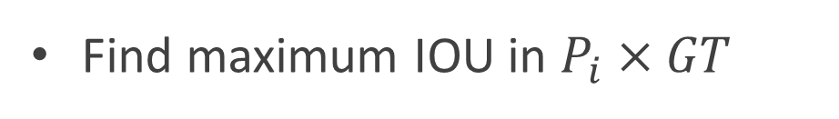
Intersection Over Union (IOU)
Find maximum IOU in $P_{i}×GT$
Intersection
IOU =
Union
Ground Truth 1
Prediction

Slide 12
Recall and Precision
Counting the correct number of detection in each image
Two measuring terms:
Correct number of detection in an image
Ground Truth
Ground Truth
U
Prediction
U
Prediction
Recall =
Precision =
Ground Truth
Prediction

Slide 13
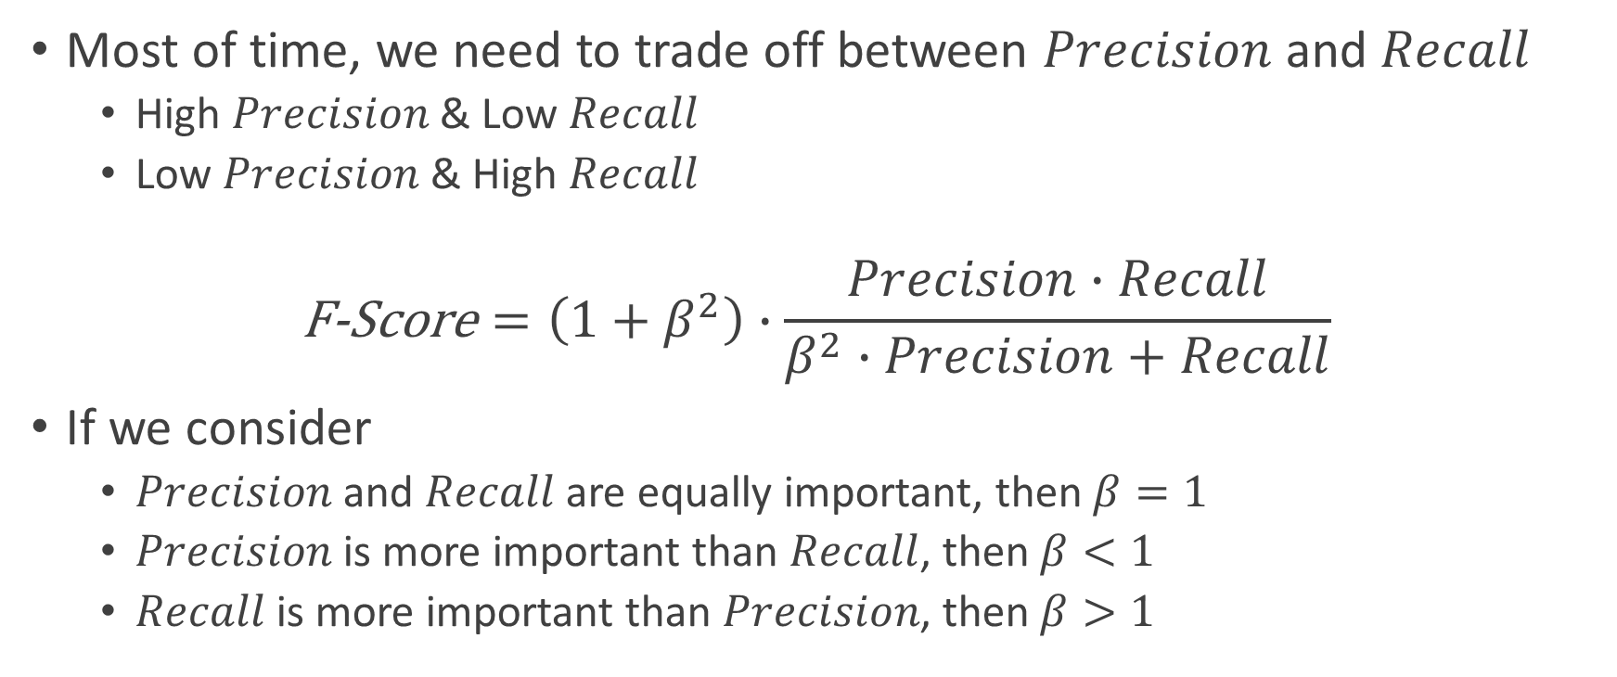
The F-Score
Most of time, we need to trade off between $Precision$and $Recall$
High $Precision$& Low $Recall$
Low $Precision$& High $Recall$
$$\text{F}\text{−}\text{Score}=\left(1+β^{2}\right)∙\frac{Precision∙Recall}{β^{2}∙Precision+Recall}$$
If we consider
$Precision$and $Recall$are equally important, then $β=1$
$Precision$is more important than $Recall$, then $β<1$
$Recall$is more important than $Precision$, then $β>1$

Slide 14
Some Tips May Help You
Any model is fine, but we suggest you use YOLOv3 model in your training work
Beware the parameters of model configuration is reasonable
Model architecture
Hyper parameters
You need to compute the F-Score, which is the key of scoring your final project, try to get best of F-Score as possible (higher is better)
Don’t forget some powerful technique
Data Argumentation
Transfer Learning

